Slide 1
Suicide Predictor
Group 5: Bernard, Rafi, Syazwan

Slide 2
Motivation

Slide 3
Suicide is a concerning issue that targets almost all nations, regardless of how developed they are
There is no single decisive factor that explains the rate of suicide
By combining several attributes of a population group, it might be possible to predict the occurrence of suicide in a nation

Slide 4
Problem Formulation

Slide 5
Are we able to predict the suicide rates based on a specific attributes of a population group that we think affect suicides?
Which model would be the best to predict the suicide rates?

Slide 6
Datasets
Consists of countries from various years including their age groups, gender, suicide number, population, suicides per 100k population, HDI for the year, gdp for the year, gdp per capita, and the generation
Consists of variables describing countries’ condition from various years including the life ladder, log GDP per capita, social support level, healthy life expectancy at birth, freedom to make life choices, generosity, perceptions of corruption, positive affect, and negative affect
https://www.kaggle.com/datasets/russellyates88/suicide-rates-overview-1985-to-2016
https://www.kaggle.com/code/gcmadhan/world-happiness-index-report/data?select=world-happiness-report.csv

Slide 7
Cleaning the dataset
Merging and cleaning the two datasets

Slide 8
Cleaning
Merged the two datasets and cleaned them by removing variables that has a lot of missing data.
Only included countries with full details from the year 2007 to 2015 with the following variables: Sex (2 groups), Age (6 groups), suicide number, suicides per 100k population, and variables that are related to a country’s condition in a given year, such as gdp per capita (log), the life ladder, the social support rating, etc.

Slide 9
EDA
Notes:
Now that we have performed some data cleaning, let’s look at the datasets and explore it to gain some new insights regarding the suicide rates and other variables that might predict the number of suicide rates in a given population group

Slide 10
The Overall Suicide Trends
Across The Globe
Notes:
Now let us look at the overall suicide trends across the globe and analyze any significant pattern that we can observe from the explored data.

Slide 11
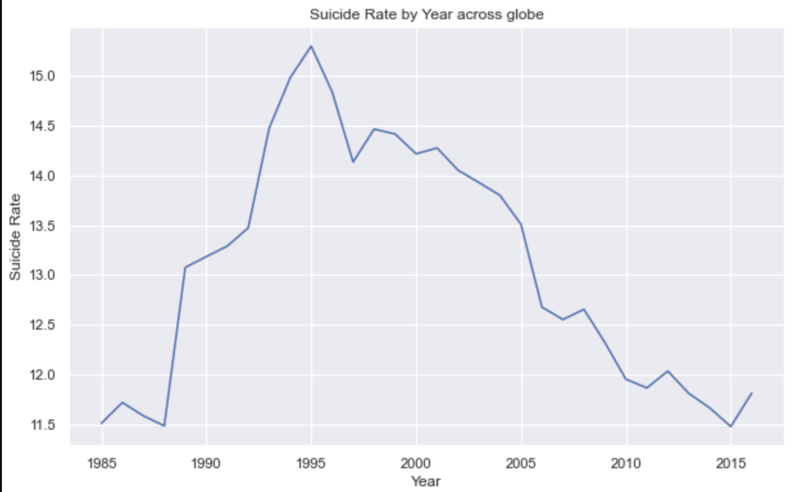
Suicide Rates (/100k population) Infographics
1000
900
Key Insight
800
The overall suicide trend after 1995 is linearly decreasing
700
600
500
400
Peak Value
300
Peak suicide rates/100k pop is 15.3 in the year 1995
200
100
2020
2021
2022
2023
2024
Notes:
From this data, we can see that from 1985 to 1995 , the suicide rate / 100k pop is linearly increasing, however, the number has decreased steadily up until the latest data point (2015). The peak sucide rates occurred in the year 1995 with 15.3 people killed themselves for every 100k population. And this number has dropped by approximately 25 percent to 11.5 per 100k population in 2015

Slide 12
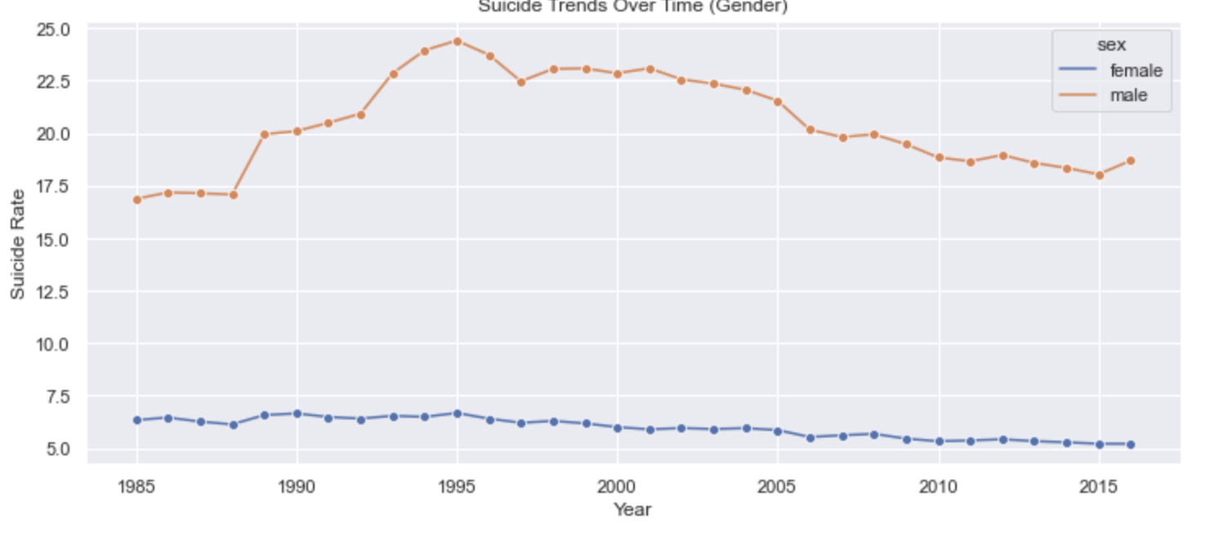
Suicide Rates (by Gender) Infographics
1000
900
Key Insight
800
Men is significantly more likely to commit suicide than women
700
600
500
400
Key Insight
300
The trend for both gender is linearly decreasing
200
100
Notes:
Now take a look at the factor that gender might have in predicting the suicide rates. Notice that the sucide rates for male has consistently been significantly higher than that of female (around 3.5x higher). Yet, for both gender, the suicide rates has been decreasing linearly.
We believe that this number reflect the lopsided pressure that society as a whole impose to the male, because they are expected to be successful in life, which causes unnecessary burden and stress to them.

Slide 13
Which age group is more likely to commit suicide?
Notes:
Lets move to other variables that might be correlated to suicide rates.

Slide 14
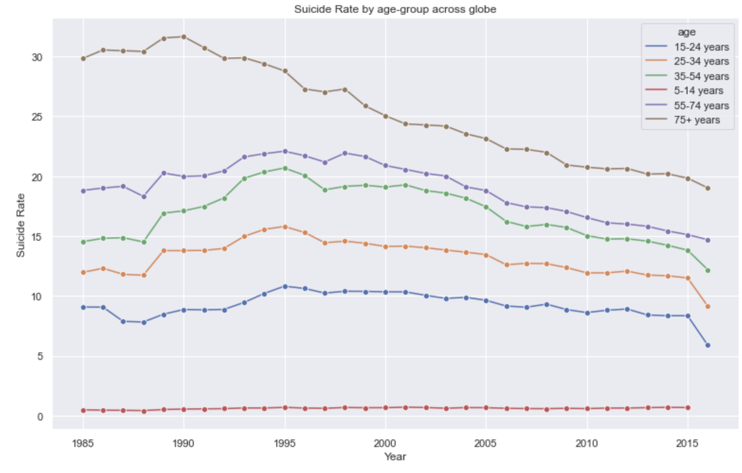
Suicide Rates (by Age-group) Infographics
1000
900
Key Insight
800
Elderly (75+ years) has the highest suicide rates
700
600
500
400
Key Insight
300
The trend for all groups is, again, decreasing
200
100
Notes:
From this diagram, notice that the likelihood of suicide increases with age, those in the 75+ years age group have the highest suicide rates.
Again, we believe that the rationale behind this figure is that the elderly often battle with physically and financially burdening chronic diseases, which prevents them from living their life happily.
Due to the clear distinction in the suicide rates for each group and gender, it might be tempting to consider these two variables when designing our model for the machine learning

Slide 15
GDP vs Suicide Rates
Notes:
Are people living in a rich country will be less likely to commit suicide?

Slide 16
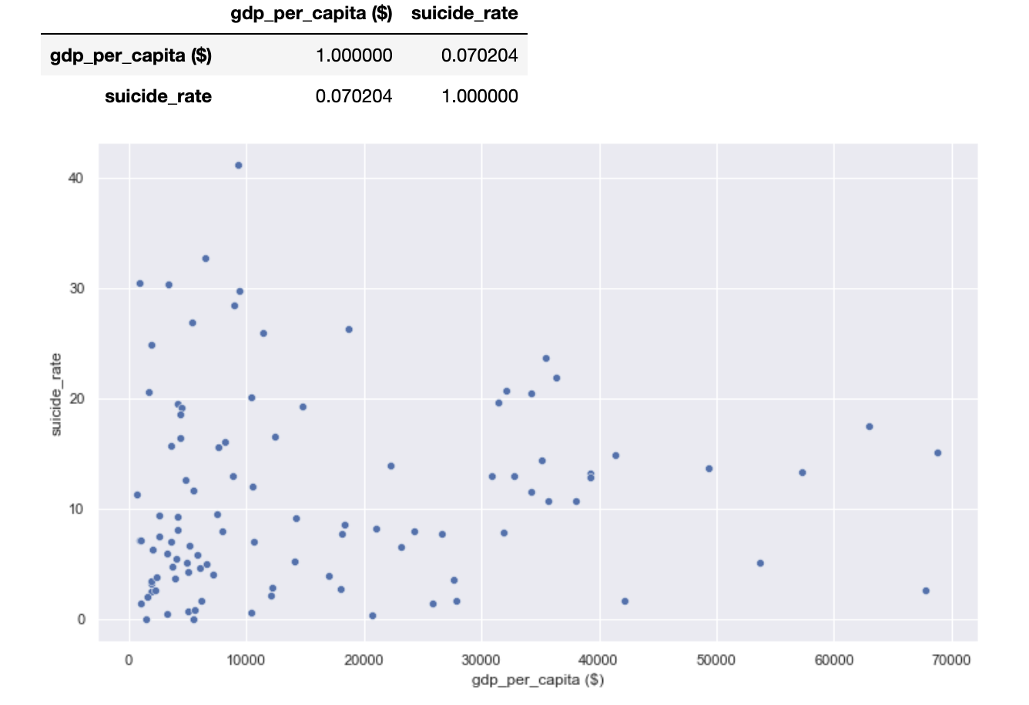
While large portion of country with high suicide rates also has low GDP/capita, suicide rates is weakly correlated with GDP
Notes:
A large portion of country with high suicide rates also has low gdp/capita. Notice that country with more than 25 suicide per 100k population all has less than 10k dollar in gdp per capita. However, from the graph, we can also see from the graph that when the gdp per capita increases above 30000, the suicide rates also go up accordingly. Thus, there is a weak or even no correlation between GDP/capita and sucide rates, which is also supported by the low correlation (0.07)

Slide 17
Trends in a country
Notes:
Now lets look at the trend in an individual country

Slide 18
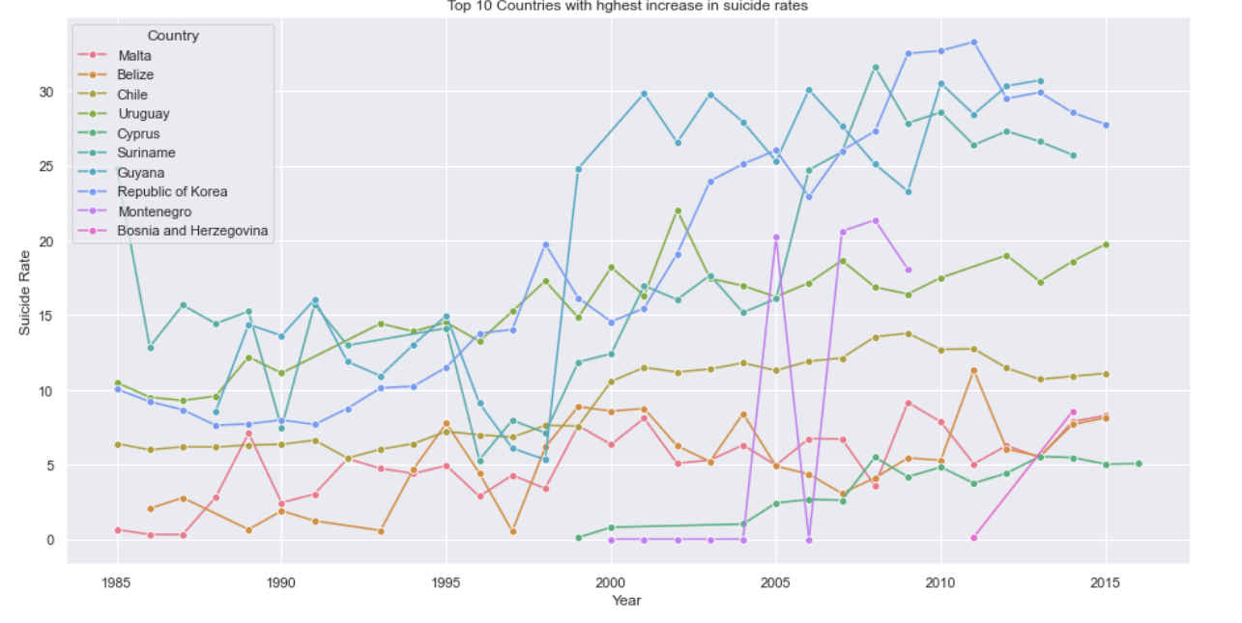
Country with Increasing Trends
Notes:
Here is the country with increasing suicide trends

Slide 19
South Korea shows the most concerning trend - an increase in suicide of 0.931 people (per 100k, per year) the steepest increase globally
Notes:
Among these countries, south korea is the country with the steepest increase globally

Slide 20
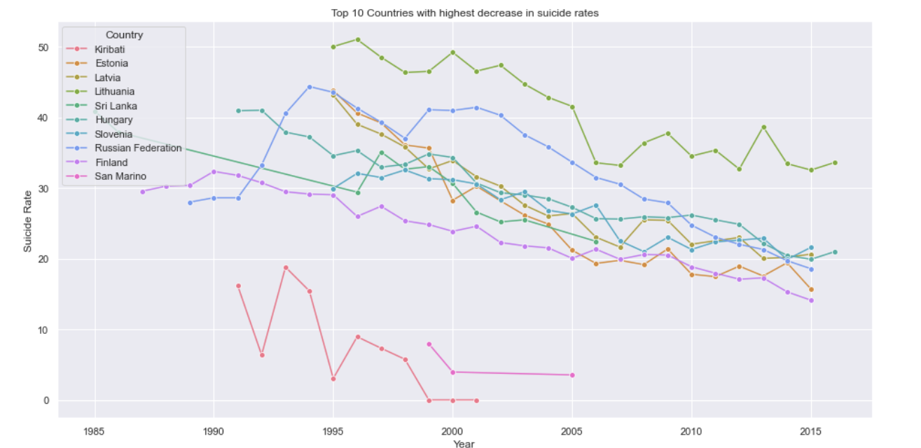
Country with Decreasing Trends
Notes:
Here is the country with decreasing suicide trends, with estonia being the country with the steepest decrease

Slide 21
Correlation between variables
Notes:
Now lets look at the individual variable and find the correlation between this variables and the sucide rates

Slide 22
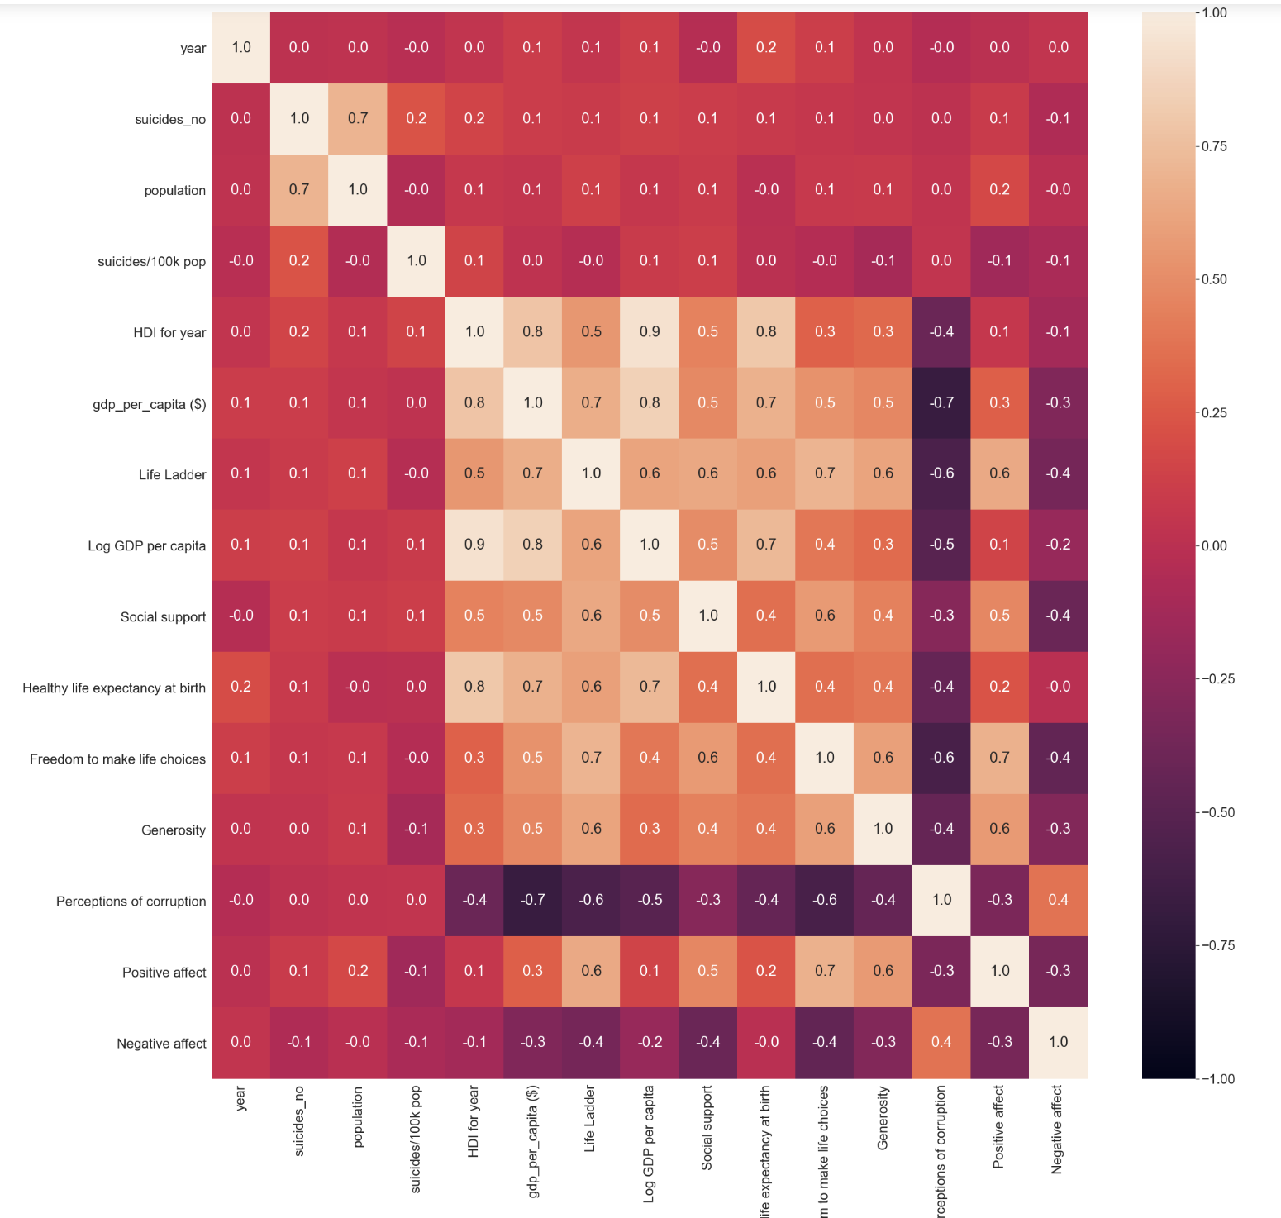

Slide 23
Suicide Rates
However, it has low correlation with other variables (all under 0.2)
Correlation with other variables
Notes:
From this heatmap notice that all variables have low correlation with the suicide rates, all below 0.2, thus there is no single variable that can singlehandedly predict the occurrence of suicide in a given population, thus univariate linear regression will not be an appropriate model to be used in this case. However, it will be tempting to see what will happen if we try other model, such as multi-variate linear regression or KNN clustering, which we will explore in a while, to predict the suicide rates

Slide 24
Machine Learning
Notes:
After gaining some insights from the EDA, let’s build a few regression models to predict the suicide rates based on variables available from our dataset. To do this, we first drop the year and countries, because we believe that the data such as perception of corruption, GDP, etc. is already enough to represent a country in a given year. Then we do One Hot Encoding to change the categorical values to numerical values

Slide 25
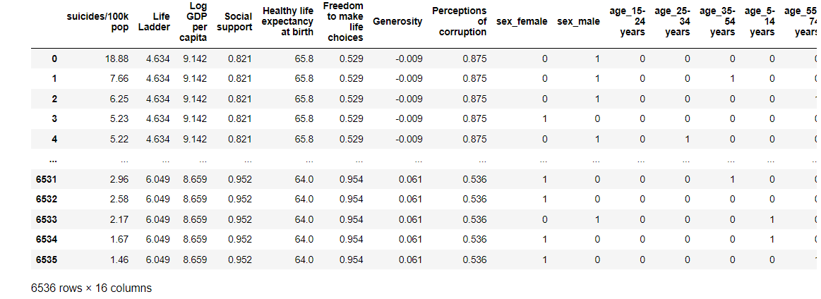
Notes:
Here are the results

Slide 26
Model 1: Multiple Linear Regression
Notes:
First, we try using multiple linear regression method to try predicting the suicide rates

Slide 27
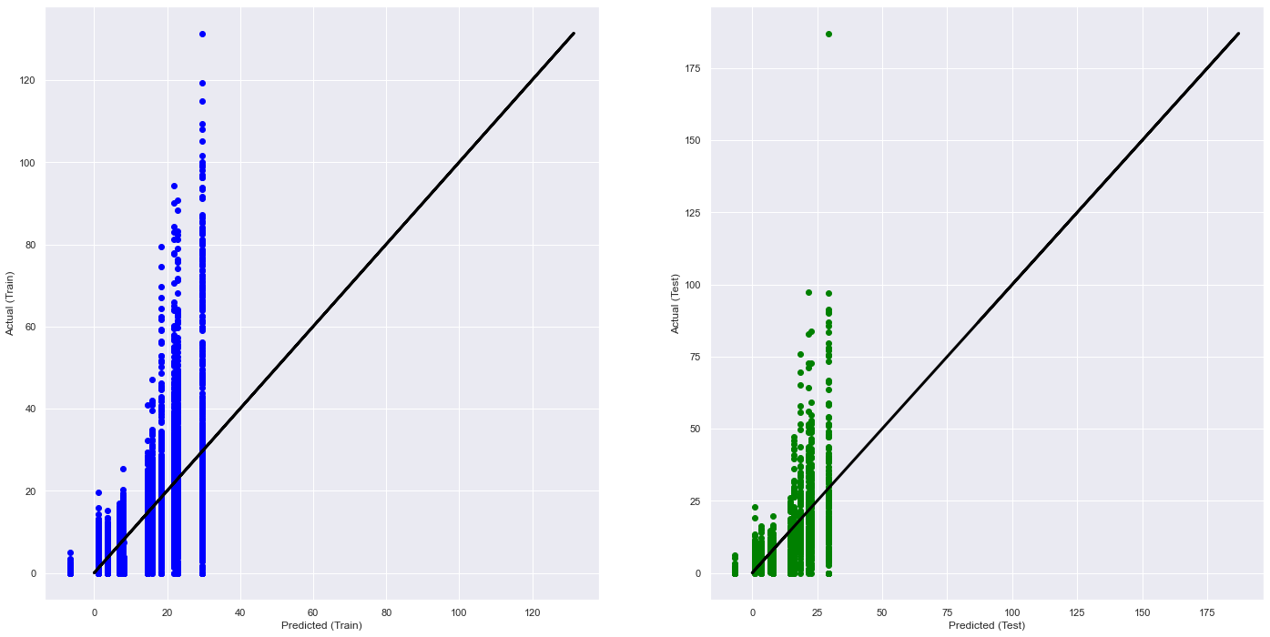
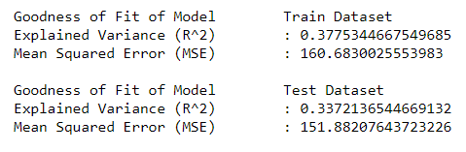
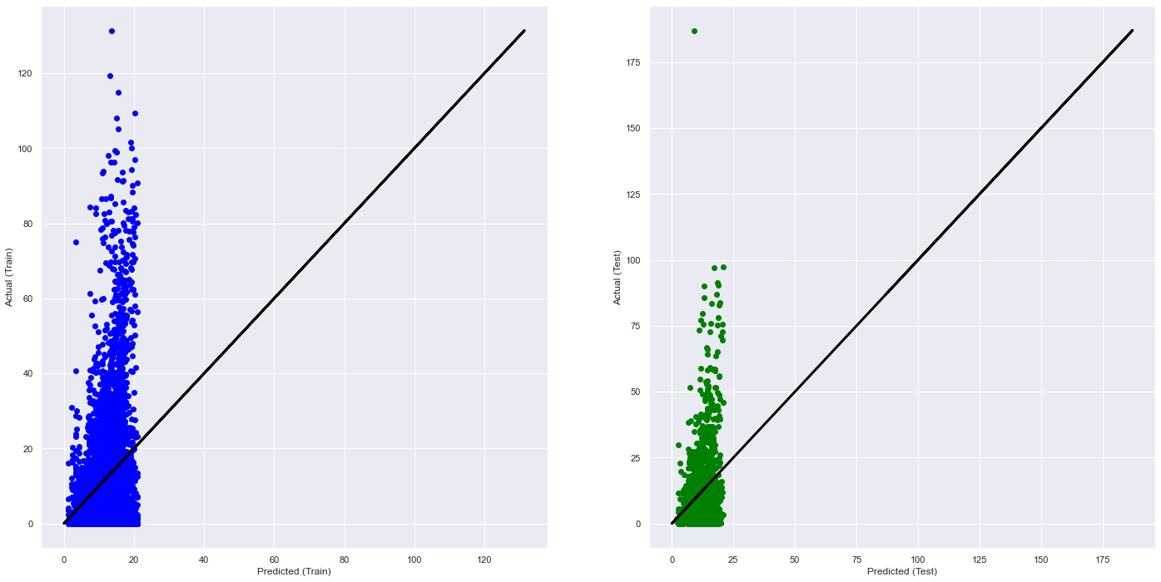
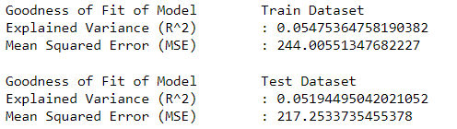
Chosen Variable
Gender & Age Group
Countries
Notes:
From the dataset, we first build a regression model using chosen variable. For the first model, we use just gender and age group to predict the suicide rates, while in the second model, we use countries information to predict the suicide rates. It can be seen that both models is not accurate in predicting suicide rates.

Slide 28
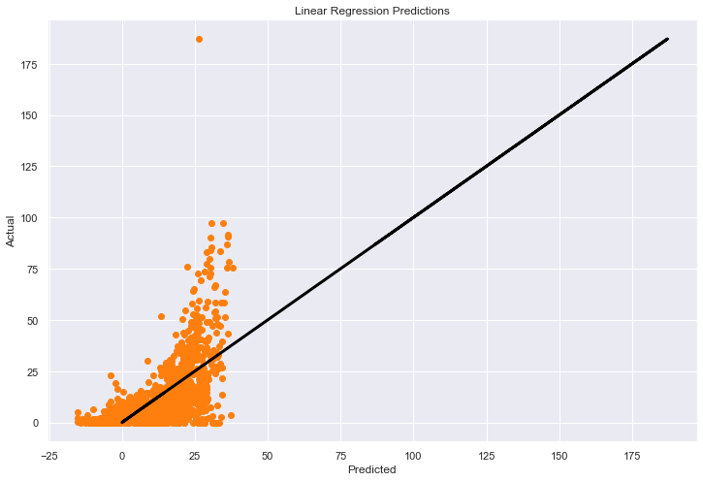

What about using all variables?
Regression Results:
Notes:
What about using all variables for multiple linear regression? While there is a bit of improvement, this models is still not accurate in predicting the suicide rates. Therefore, we think that linear regression is not suitable because linear regression assumes that the relationship between the variables in linear, which might not be true for this models.

Slide 29
Model 2: K-Nearest Neighbors Regressor
Notes:
Then we try KNN Regressor. The K-Nearest Neighbors algorithm assumes that similar things exist in close proximity. In other words, similar things are near to each other.

Slide 30
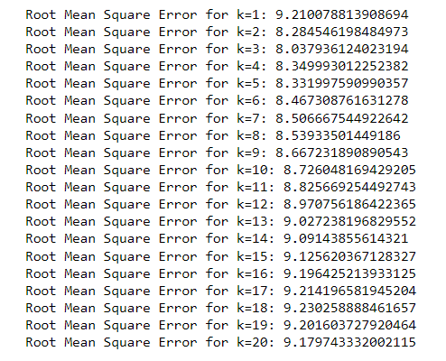
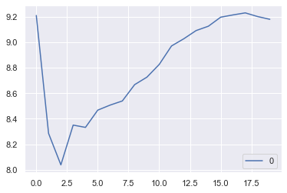
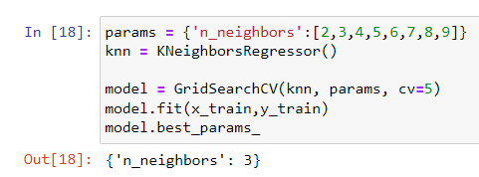
Finding the Optimal Value for K
Notes:
For this, we need to find ‘K’ which is number of nearest neighbors, we compare Root Mean Square Error value and use Grid Search Cross Validation to find the optimal K, which equals to 3

Slide 31

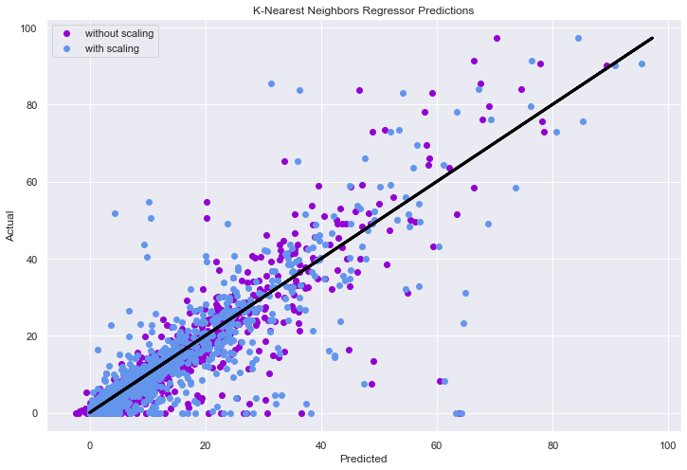
K-Nearest Neighbors Regressor Model
Regression Results:
Model Score Without Scaling: 0.682
Model Score With Scaling: 0.745
Notes:
We also use MinMaxScaler to improve the models. We can see that the model score is increasing we we use scaling. Scaling the models makes it easy for a model to learn and understand the problem.

Slide 32
Model 3: Random Forest Regressor
Notes:
We also try the random forest regressor. Random forest is a estimator that fits a number of classifying decision trees on various sub-samples of the dataset and uses averaging to improve the predictive accuracy and control over-fitting.

Slide 33
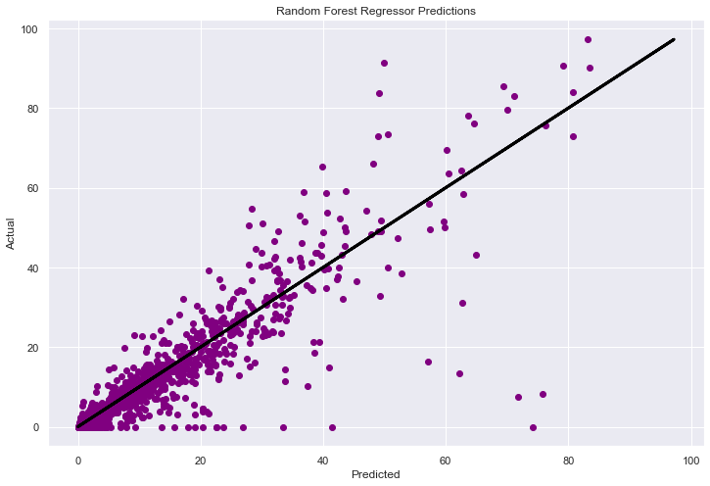
Random Forest Regressor Model
Regression Result:
Model Score: 0.788
Notes:
This Model is slightly better than KNN regressor

Slide 34
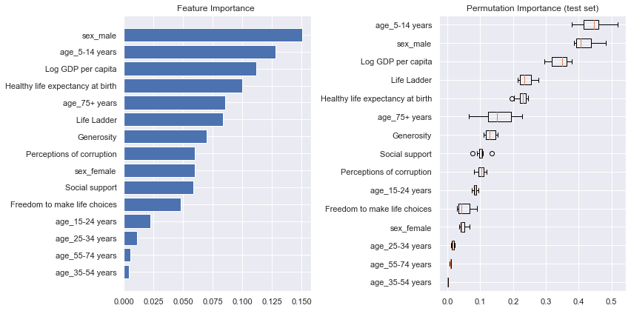
Feature and Permutation Importance
Notes:
Here are the features ranked based on the order of its importance in Random Forest Regression

Slide 35
Model 4: Gradient Boosting Regressor
Notes:
Another model that we use is Gradient boosting regressor. Gradient boosting is a type of machine learning boosting. It relies on the intuition that the best possible next model, when combined with previous models, minimizes the overall prediction error.

Slide 36
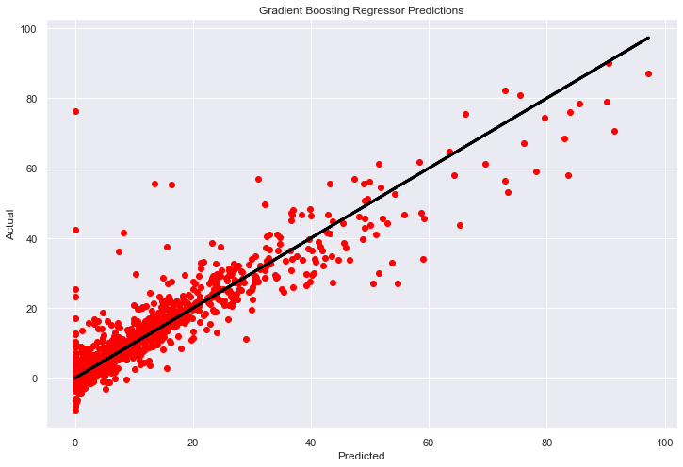
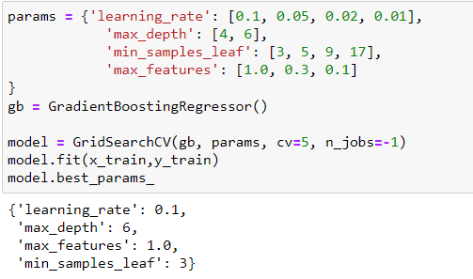
Gradient Boosting Regressor Model
Regression Result:
Model Score: 0.849
Notes:
We tuned the hyperparameter using Grid Search Cross Validation and our models received 0.849 score, which is a drastic improvement from the other models

Slide 37
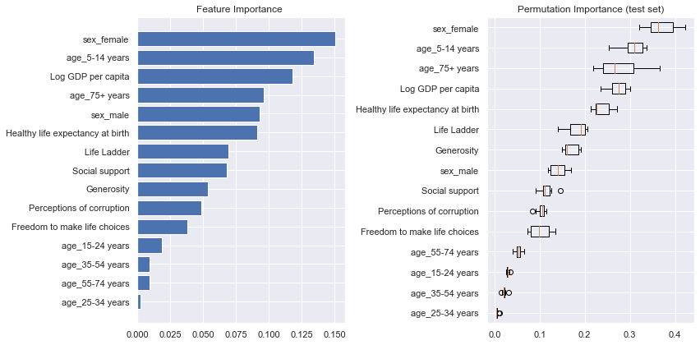
Feature and Permutation Importance
Notes:
Here are the features ranked based on the order of its importance in Gradient Boosting Regression

Slide 38
Model 5: Voting Regressor
Notes:
Last but not least, we use voting regressor to combine all of the regression models that we have made

Slide 39
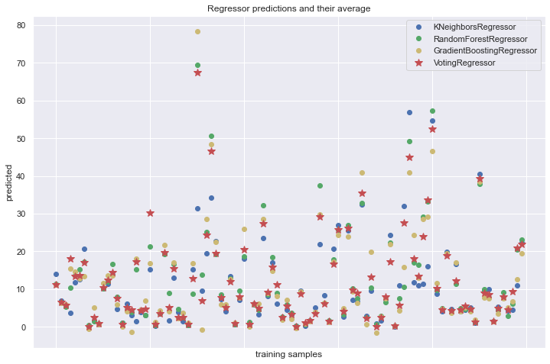
How Voting Regressor Works?
Notes:
This regression models averages the individual prediction of each regression models to form a final prediction, as seen in the graph

Slide 40
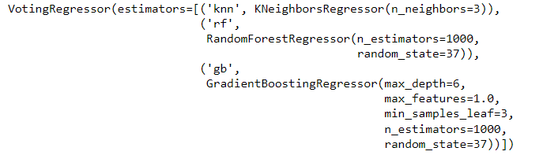
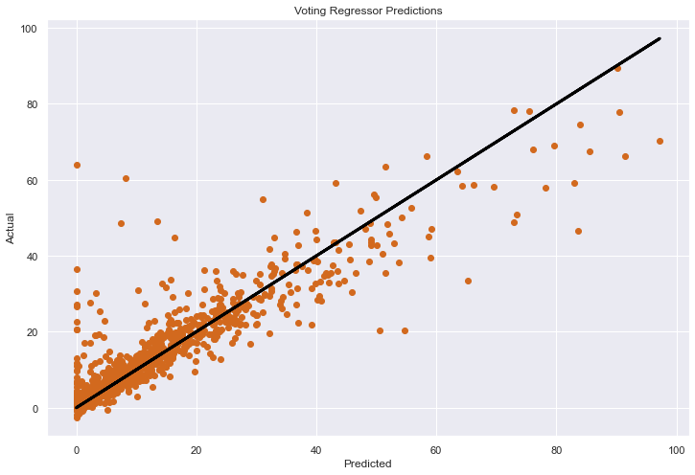
Voting Regressor
Regression Result:
Model score: 0.830
Notes:
It turns out that the models is slightly less accurate than a Gradient Boost Regressor, but is still achieve a good accuracy

Slide 41
Comparing Regression Models
Notes:
Now lets compare the models that we have built

Slide 42
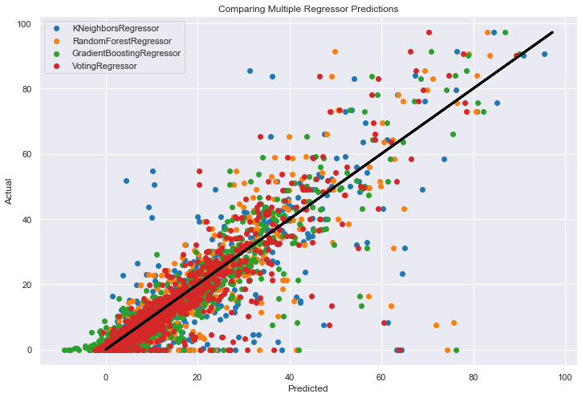

Comparing Regression Models
Notes:
From the graph, we can see that all regression models is quite good in predicting suicide rates. However, the Gradient Boosting Regressor has the highest accuracy with score: 0.85, while K Neighbors Regressor is the least accurate with score: 0.75.

Slide 43
Project Conclusion

Slide 44
What we have learned
Merging Two datasets that have imbalance number of rows and find the common subset for both datasets
Scaling the dataset to achieve better machine learning result, for example MinMaxScaler()
Grid Search Cross-Validation to select the best hyperparameters for a machine learning model
Feature Importance and Permutation Importance to rank the “importance” of features in a model
K Nearest Neighbors Regressor
Random Forest Regressor
Gradient Boosting Regressor
Voting Regressor
Notes:
This Part just read from the slide

Slide 45
Question 1
We cannot rely on a single variable or predictor to predict suicide rates
However, when we combine every possible variables to build our model, a satisfactory result is produced
There is a complex interplay of problems that leads to suicide
Only provide macroscopic variables, and ignore microscopic details that vary from people to people
Are we able to predict the suicide rates based on specific attributes of a population group that we think affect suicides?
Notes:
After exploring the datasets, and building a machine learning model, we answer the question that we pose at the beginning of our project, Are we able to predict the suicide rates based on a specific attributes of a population group that we think might explain suicide rates?,
And here are our insights:
1. Each variable has low correlation with the suicide rates and thus, we cannot rely on a single variable to predict suicide rates
2. However, when we include all the variables that we have and fine-tuned our models, the accuracy increases dramatically.
3. We feel that suicide consist of complex interplay between some variables, that individually does not amount to suicide, just like the swiss cheese model
4. Our best models can achieve an accuracy score of 0.85, which is a great model performance score in predicting suicide rates.
5. However, there must be something else that explains suicide. Therefore, we recommend that the models can still be improved given more data and variables to work with
6. We believe that this “something else” is the microscopic factor that varies from every individual. Our model only take into account macroscopic factor of a country, but fail to consider the uniqueness of each Individual.

Slide 46
Question 2
It is quite clear that Multiple Linear Regression is not a good model
Scaling the data is important in some models
Hyperparameters needs to be tuned to improve the linear regression models
Overall, Gradient Boosting Regressor is the best model to predict suicide rates
Which model would be the best to predict the suicide rates?
Notes:
For the second question,we arrive at the conclusion that Gradient Boosting Regressor is the best model to predict suicide rates from 5 models that we builds,while Linear Regression is the least suitable. Scaling and Hyperparameter Tuning is also important to improve the models

Slide 47
Thank You

